Slide 1
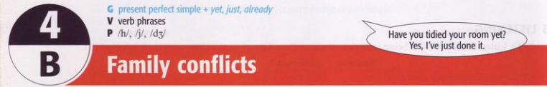
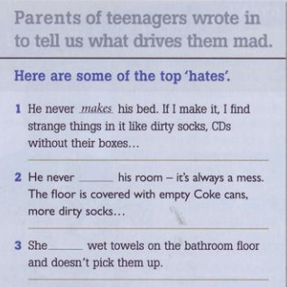
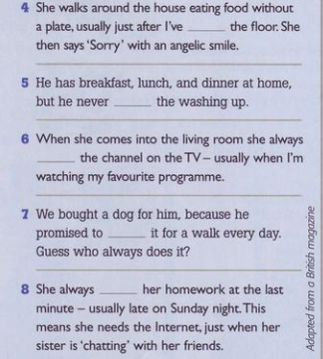
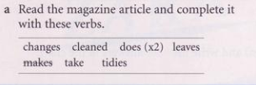
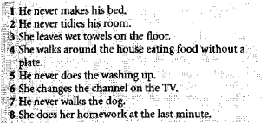
cleaned
does
changes
tidies
take
leaves
does
drives them mad = makes them angry

Slide 2
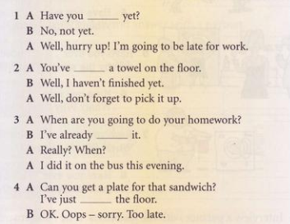
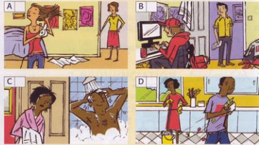

finished
2
3
left
done
1
4
cleaned

Slide 3
c Look at the conversations and underline just, yet, and already. What tense is the verb with them? What do you think they mean?
just (in the contex) = a very short time ago
already + earlier than expected
yet = until now
Note: Just has other meangings in other contexts, e.g. only

Slide 4
We use Yet in (-) and (?) sentences to ask if something is going to happen has happened or say it hasn’t happened.
Psesent perfect + yet, just, already
Yet
Yet is put at the end of the sentence.
Ex: Has your course started yet?
I haven’t received a letter from him yet.

Slide 5
We use Just in (+) sentences to say that something happened recently.
Just
Just is put after the auxiliary verb “have/ has” and before the past participle (main verb).
Ex: I’ve just seen Susan coming out of the cinema.
Mike’s just called. Can you ring him back please?

Slide 6
We use Already in (+) sentences to say that something happened before now or earlier than expected.
Already
Already is put after the auxiliary verb “have/ has” and before the past participle (main verb) and it’s also put at the end of the sentence.
Ex: I have already been to Tokyo or I have been to Tokyo already.
The train has already left. What are we going to do?

Slide 7
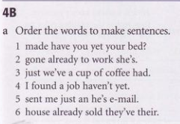
Excercises:
1 Have you made your bed yet?
2 She’s already gone to work.
3 We’ve just had a cup of coffee.
4 I haven’t found a job yet.
5 He’s just sent me an e-mail.
6 They’ve already sold their house.

Slide 8
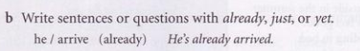
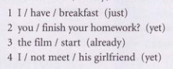
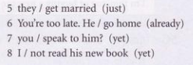
1 I’ve just had breakfast.
2 Have you finished your homework yet?
3 The film has already started.
4 I haven’t met his girlfriend yet.
5 They’ve just got married.
6 You’re too late. He’s already gone home.
7 Have you spoken to him yet?
8 I haven’t read his new book yet.

Slide 9
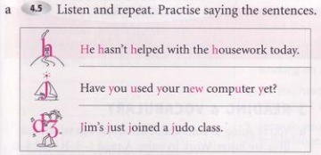
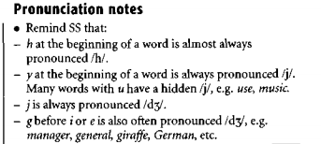

Slide 10
1 She’s just broken a place.
2 They’ve just got married.
3 He’s just taken a photo.
4 She’s just seen a mouse.
5 The film has just finished.
6 The dog has just seen a cat.

Slide 11
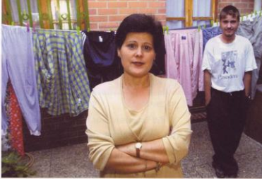
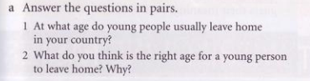
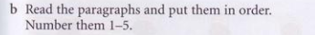

Slide 12
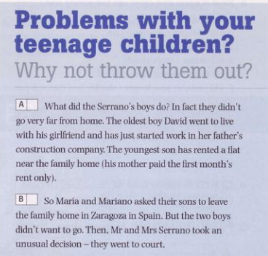
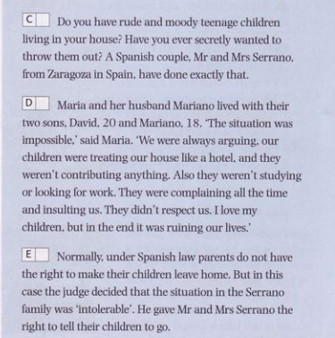
1
2
5
3
4

Slide 13
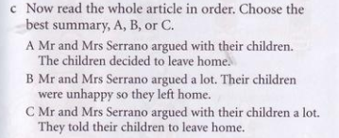
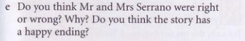
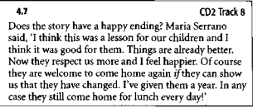
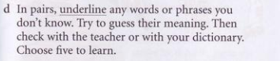

Slide 14
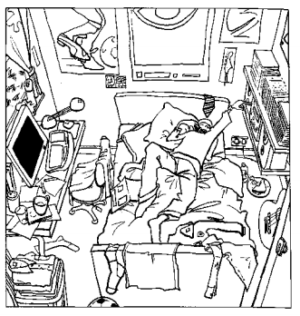
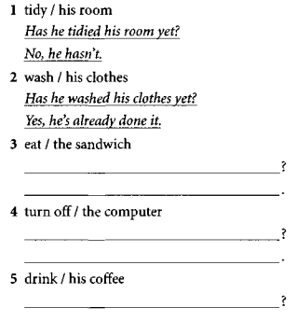
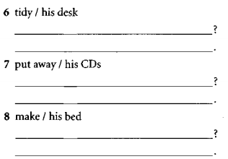
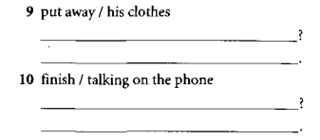
Excercises:
Has he tidied his desk yet?
No, he hasn’t
Has he put away his CDs yet?
Yes, he has already done it
Has he made his bed yet?
Has he eaten the sandwich yet?
No, he hasn’t
No, he hasn’t
Has he put away his clothes yet?
Has he turned off the computer yet
No, he hasn’t
Yes, He’s already done it
Has he finished talking on the phone yet?
Has he drunk his coffee yet?
Yes, he’s already finished it
No, he hasn’t

Slide 15
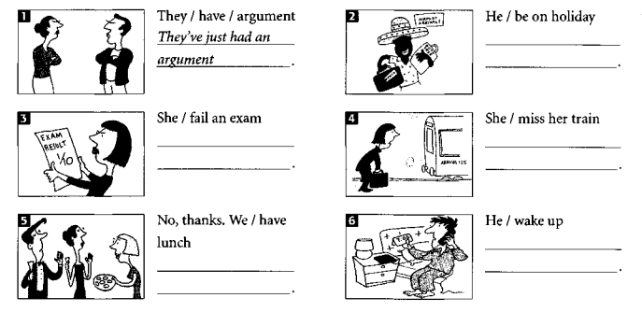
He’s just been on holiday
She’s just fallen an exam
She’s just miss her train
He’s just wake up
No, thanks. We’ve just had lunch

